Slide 1

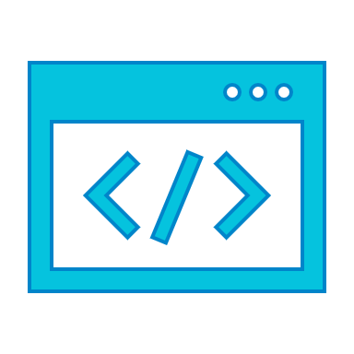




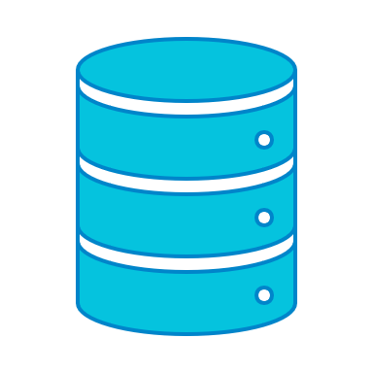

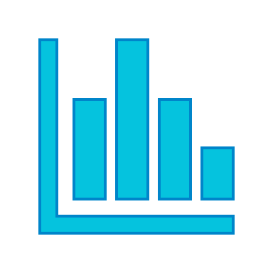
Development Ecosystem
GitHub
git
conda
conda
Python
Anaconda
packages,
libraries,
tools
Studio3T
PyCharm
Jupyter
Postman
MongoDB
Tableau

Slide 2
Development Ecosystem:
Tools Defined
Programming language used to instantiate logic. Python uses many open source libraries to augment native functionality, including pandas, numpy, scikit-learn and much more.
packages,
libraries,
tools
Python
GitHub is an online platform used to host and collaborate on code. We can share insights, compare commit messages, and learn more about teams work together. git uses the command-line-interface to communicate with GitHub directly.
GitHub
git
PyCharm and Jupyter are places to develop code. Technically, PyCharm is an IDE (Integrated Development Environment) to help manage bugs, syntax errors and much more. Jupyter is an environment best suited for presenting code, by segmenting the code into kernels that can operate independently.
PyCharm
Jupyter
Anaconda is a data science platform that streamlines access to a collaborate environment. We use Anaconda to import libraries (and manage their concurrent dependencies), launch Jupyter / other IDE’s, and more. Conda uses the command-line-interface to communicate with Anaconda. We can save Anaconda envs to GitHub.
Anaconda
conda

